Slide 1
KES Bath Physics Department
The Laws of Thermodynamics

Slide 2
Why bother?
These are not explicitly mentioned on the syllabus
Many people would regard this as an intellectual outrage
Also, many of you are going on to study subjects which will require anything from a general (e.g. Biochemistry) to a very detailed (e.g. Mechanical Engineering) understanding of them

Slide 3
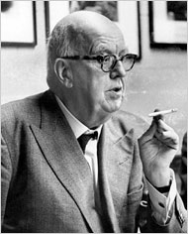
CP Snow and The Two Cultures (1959)
A good many times I have been present at gatherings of people who, by the standards of the traditional culture, are thought highly educated and who have with considerable gusto been expressing their incredulity at the illiteracy of scientists. Once or twice I have been provoked and have asked the company how many of them could describe the Second Law of Thermodynamics. The response was cold: it was also negative. Yet I was asking something which is about the scientific equivalent of: ‘Have you read a work of Shakespeare’s?’

Slide 4
CP Snow and The Two Cultures (1959)
I now believe that if I had asked an even simpler question – such as, What do you mean by mass, or acceleration, which is the scientific equivalent of saying, ‘Can you read?’ – not more than one in ten of the highly educated would have felt that I was speaking the same language. So the great edifice of modern physics goes up, and the majority of the cleverest people in the western world have about as much insight into it as their Neolithic ancestors would have had.

Slide 5
Quick background
In the 18th century, there was debate about the nature of what we now call energy, heat and work and how they might be related
Over the first half of the 19th century, our modern understanding was slowly established
Initially there were many laws and rules suggested, many of which needed tidying up later into the bare minimum laws needed
Several of the Laws can be stated in different but equivalent ways

Slide 6
Timeline (approximate)
1824 – 2nd Law
1850 – 1st Law
1912 – 3rd Law
1930 – 0th Law

Slide 7

Definitions
A (closed) system
  Any (isolated) part of the Universe we are considering
Work (W )
  $\sum{F\text{δ}x}$ (or $\sum{p\text{δ}V}$ for a gas)
Internal Energy (U )
  $\sum{(KE+PE)}$ for all the particles in a system
Thermal (Heat) Energy (Q )
  Energy transferred from one body to another as a result of a difference in temperature between them

Slide 8
The Zeroth Law of Thermodynamics
A
B
C
‘0ThD’ for short (like N(II))
If Body A is in thermal equilibrium with Body B and Body B is in thermal equilibrium with Body C, then Body A is in thermal equilibrium with Body C
Obvious?
Without this, temperature could not be defined or measured in a non-circular way

Slide 9
The First Law of Thermodynamics (1ThD)
How many ways can the Internal Energy (U ) of a system be increased?
Two (and only two):
  Transfer thermal energy (Q ) to it
  Do work (W ) on it

Slide 10
The First Law of Thermodynamics (1ThD)
Rudolph Clausius (1850):
  In all cases in which work is produced by the agency of heat, a quantity of heat is consumed which is proportional to the work done; and conversely, by the expenditure of an equal quantity of work an equal quantity of heat is produced
  In a thermodynamic process involving a closed system, the increment in the internal energy is equal to the difference between the heat accumulated by the system and the work done by it.

Slide 11

1ThD
For a closed system:
$$∆U=∆Q+∆W$$
  $∆U=$ increase in Internal Energy of the system
  $∆Q=$ Heat Energy supplied to the system
  $∆W=$ Work Done on the system
1ThD = Conservation of Energy
Examples:
  Squashing a gas
  Boiling a kettle

Slide 12

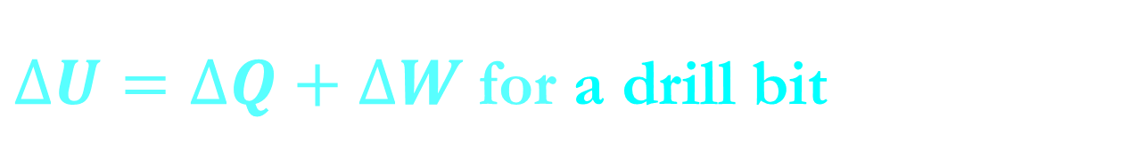
$∆U=∆Q+∆W$for a drill bit
Shortly after use, a drill bit is hot
  $∆U$ is large and positive
  Because Work has been done on it ($∆W$ is large and positive)
  $∆Q≈$ 0 (wall and drill bit started at the same temperature)

Slide 13

$∆U=∆Q+∆W$for a drill bit
Some time later, the drill bit is cool
  $∆U$ is large and negative (particles have less KE and same PE)
  $∆Q=$ large and negative (thermal energy has been lost to surroundings)
  $∆W$ $≈$ 0

Slide 14
The Second Law of Thermodynamics (2ThD)
Most laws in Physics are time-reversible
So why do many things only happen one way round?
  Wood burns to make ash, but ash cannot be made into wood
  Plates fall and smash, but they never reform and jump onto shelves
  Pendulums slow down and stop, but they never spontaneously start swinging from rest
There is nothing in the laws of Physics that forbids any of these things

Slide 15

The Second Law of Thermodynamics (2ThD)
A new quantity is needed: Entropy (S )
‘A measurement of the disorder of a system’
Definition:
$$S=k \text{ln} W$$
k = Boltzmann’s constant
W = the number of equivalent arrangements of the system
Units of S are JK⁻¹

Slide 16
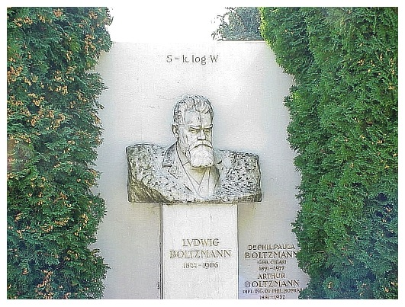
Boltzmann’s tombstone

Slide 17
Entropy example
Consider a box with a partial partition
Put 24 gas particles in the box as shown
How many ways are there of arranging the particles like this?
W = 24
S = k ln W = 4.4 × 10⁻²³ JK⁻¹

Slide 18
Entropy example
Same box, same number of particles but different arrangement
How many ways are there of arranging the particles like this?
W = ²⁴C₁₂ = 2 704 156
S = k ln W = 2.0 × 10⁻²² JK⁻¹ (about five times higher)

Slide 19
Low Entropy
High Entropy
Which is more likely as time goes by:
  Low entropy to high entropy (dS > 0)?
  High entropy to low entropy (dS < 0)?

Slide 20
Energy changes result in a more disordered (higher entropy) state
  Dropping an object onto a desk
  A plate falling and smashing
dS > 0
2ThD means perpetual motion machines are impossible

Slide 21
Alternative statements of 2ThD
Carnot (1850):
  Heat can never pass from a colder to a warmer body without some other change, connected therewith, occurring at the same time
Although it doesn’t seem like it, this is an alternative statement of 2ThD

Slide 22
2ThD and efficiency
1ThD (conservation of energy) limits the efficiency of any device to ≤ 100%
2ThD gives a way of calculating the maximum thermal efficiency of any device

Slide 23
2ThD and efficiency
T_{h}
Q
W
Q - W
T_{c}
Consider a hot reservoir (e.g. burning fuel) and a cold sink (e.g. the surroundings)
Heat Energy Q will transfer from T_{h} to T_{c}
Useful work W can be extracted from Q by an engine as it does so
If you reverse this engine, what does it become?

Slide 24
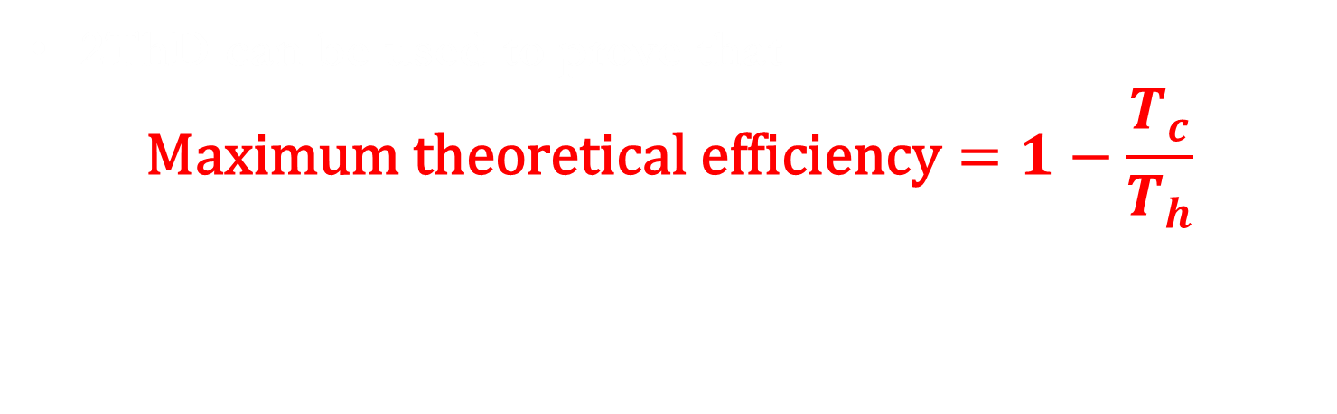
2ThD and efficiency
T_{h}
Q
W
Q - W
T_{c}
2ThD can be used to prove that
$$\text{Maximum} \text{theoretical} \text{efficiency}=1−\frac{T_{c}}{T_{h}}$$

Slide 25

$$\text{Maximum} \text{theoretical} \text{efficiency}=1−\frac{T_{c}}{T_{h}}$$
Calculate the highest efficiency a power station could have with a steam temperature of 570°C on a day when the external temperature is 15°C (the answer is not 97%!)
Are power stations more efficient in summer or winter?
How could you make a heat engine with an efficiency of 100%?

Slide 26
The Third Law of Thermodynamics (3ThD)
Several equivalent statements, but the most straightforward is:
  It is impossible by any procedure, no matter how idealized, to reduce the temperature of any system to zero temperature in a finite number of finite operations
Even in a theoretical situation, you would need an infinite amount of time or energy to do so

Slide 27
Current world records
1999, Finland:
  100 pK, small number of Rhodium atoms
2014, Italy:
  0.006 K in a 1m³ Copper vessel for 15 days

Slide 28
3ThD and efficiency
2ThD showed us that an efficiency of 100% was possible, in theory, if T_{c} = 0K
3ThD states that 0K is impossible, even theoretically
Therefore an efficiency of 100% is impossible, even theoretically and even if friction and all other energy losses are totally eliminated

Slide 29
Engineers’ statements of ThD
1ThD: you can’t win, you can only break even
  ‘Winning’ means getting more energy out than you put in, i.e. an efficiency of >100% is impossible
2ThD: you can only break even at absolute zero
  An idealised heat engine could deliver an efficiency of 100%, but only if its cold sink were maintained at zero Kelvin
3ThD: you can’t reach absolute zero

