Slide 1
Scaling objects up
Stress, Compressive strength,
Elephants, Gazelles, Giant Mutant Ants,
Galileo, and why bubbles, raindrops and planets are spherical

Slide 2

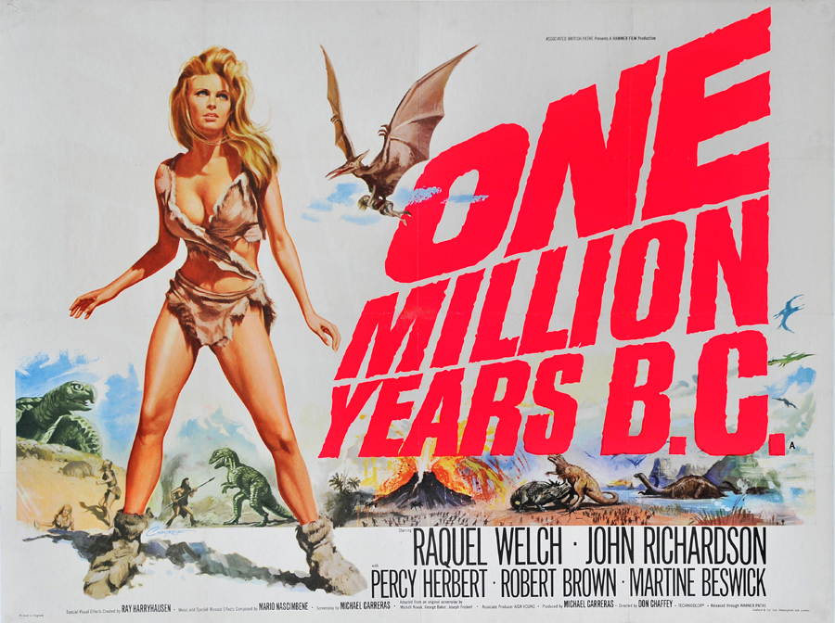
The giant animal is a favourite of cheap disaster/ horror films
Them (1954)
One Million Years B.C. (1966)
Notes:
www.youtube.com/watch?v=qcV78KE38J4

Slide 3
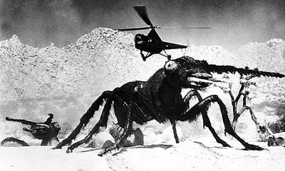
What Physics problem is there with this idea?

Slide 4
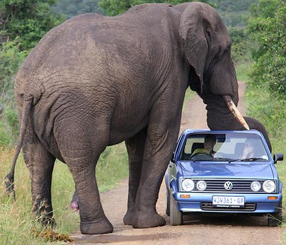
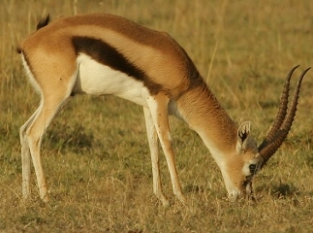
Is this possible?
Why aren’t ants the same size as hippos?
What do we see in the natural world?
Not all dimensions scale the same way

Slide 5
Why don’t gazelle-sized animals have thick legs?
Why don’t elephant-sized animals have thin legs?
Compressive Yield Strength of Bone ≈ 150 MPa
Calculate the minimum diameter of leg bone required to support
  a 5000 kg elephant, and
  a 20 kg gazelle
  (remember that both animals have four legs!)
Notes:
1 cm
0.7 mm

Slide 6

Scaling animals up
Gazelles are about 50cm tall
Elephants are about 3m
Elephants are therefore $\frac{3}{0.50}=6$ times taller than gazelles
However, they are $\frac{5000}{20}=250$ times more massive
Why are they not simply 6 times more massive?
This is not an animal-specific problem:
  The compositions of Jupiter and the Sun are roughly similar
  Yet R_{Sun} = 9.7 × R_{Jupiter} but M_{Sun} = 1050 × M_{Jupiter}
Notes:
http://galileo.phys.virginia.edu/classes/609.ral5q.fall04/LecturePDF/L14-GALILEOSCALING.pdf

Slide 7

Simpler objects
Consider a cube of side length $x$, made of material of uniform density $ρ$
Its surface area would be:
Its Volume would be:
And its mass would be:

Slide 8

Simple objects
Now consider a cube of side length $2x$, made of the same material
Its surface area would be:
Its Volume would be:
And its mass would be:

Slide 9
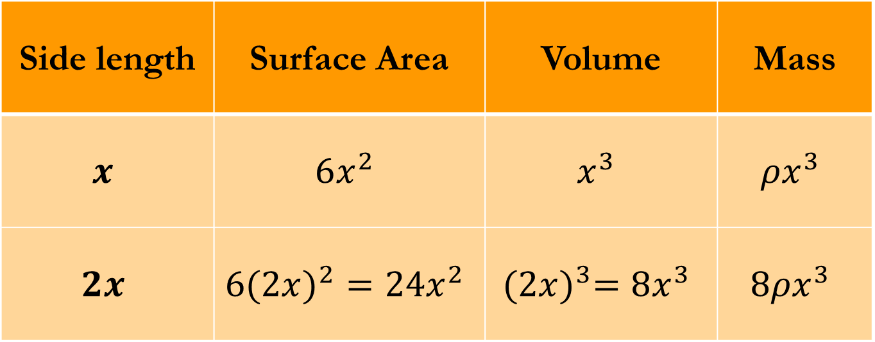
Side length | Surface Area | Volume | Mass
$$x$$ | $$6x^{2}$$ | $$x^{3}$$ | $${ρx}^{3}$$
$$2x$$ | $${6(2x)}^{2}=24x^{2}$$ | $${(2x)}^{3}=8x^{3}$$ | $${8ρx}^{3}$$

Slide 10

Back to gazelles and elephants
Elephants are 6 times taller than gazelles, but 250 times more massive
Why are they not simply 6 times more massive?
$m=ρV$ so $m∝V$ for objects of the same/similar density
Height is a linear dimension, Volume is cubic
$V∝h^{3}$ (roughly, in the case of an animal)
6³ = 216 ≈ 250
Notes:
http://galileo.phys.virginia.edu/classes/609.ral5q.fall04/LecturePDF/L14-GALILEOSCALING.pdf

Slide 11
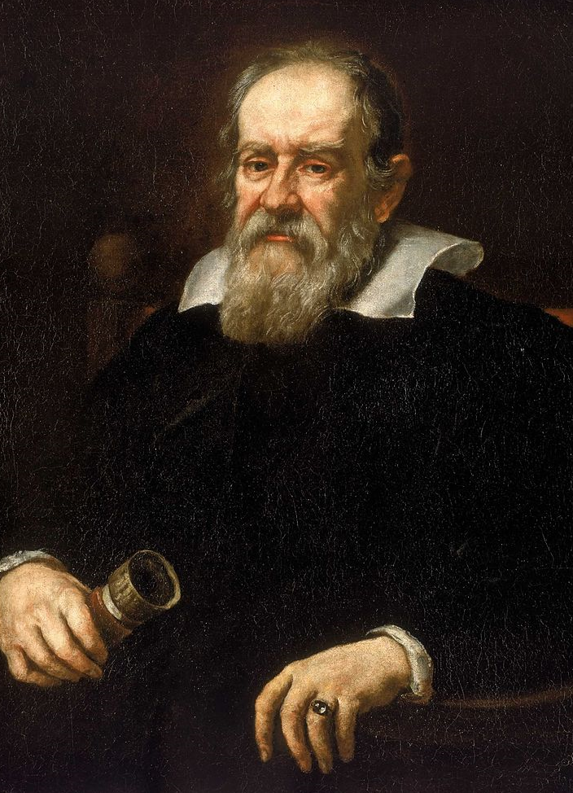
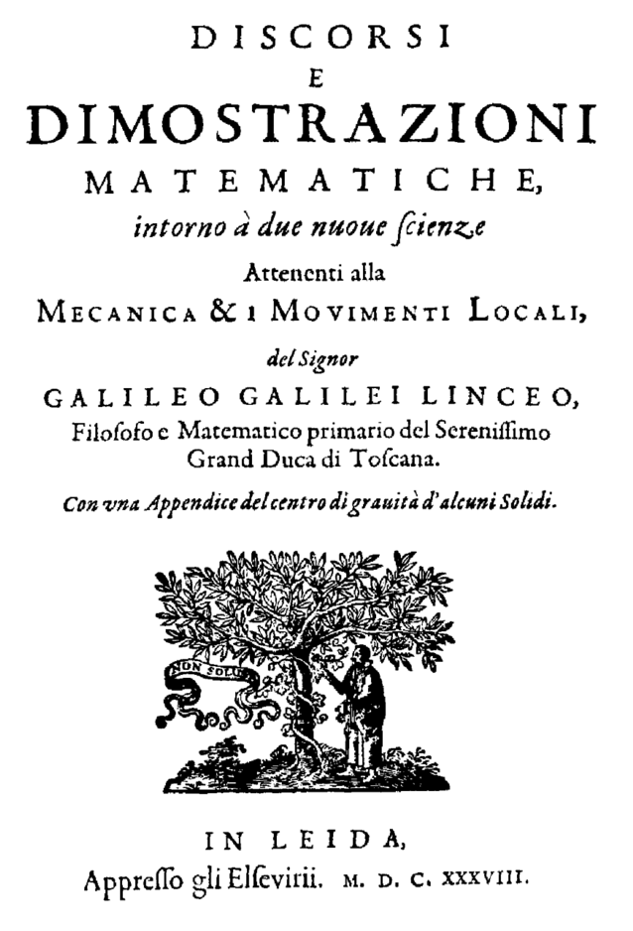
Where does Galileo fit into this?
In 1638, Galileo published Two New Sciences, where he explained the square-cube law relating an object’s volume to its area

Slide 12
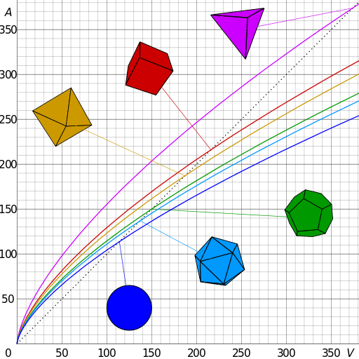

Why are raindrops and bubbles spherical?
A sphere has the smallest Surface Area to Volume ratio of any shape
Surface tension forces try to minimise the surface area of raindrops and soap bubbles

Slide 13
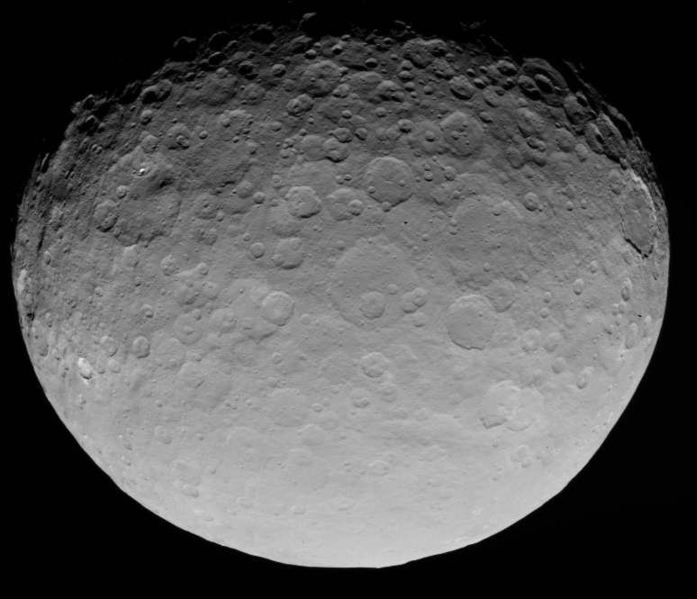
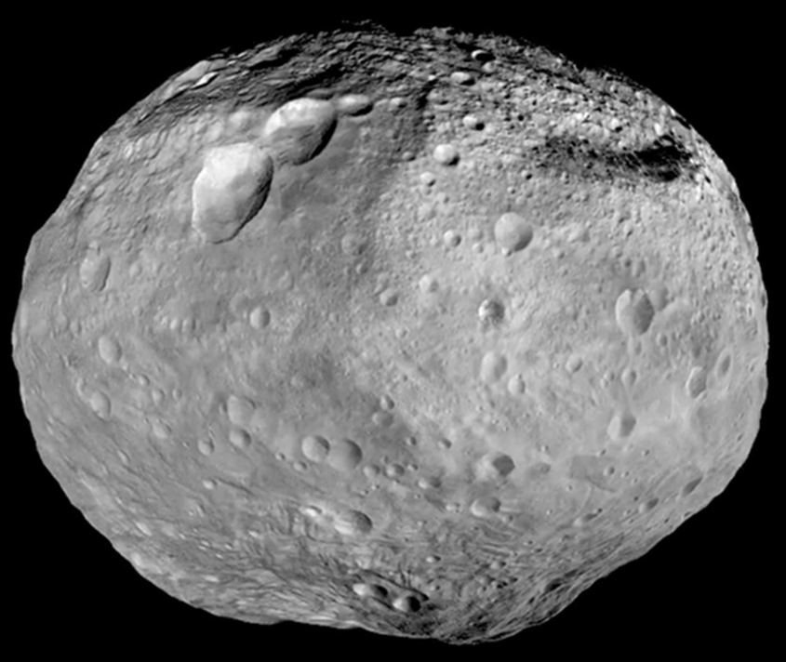
What about planets?
Gravity does the same to planets, as long as the yield strength of the rock can be overcome
Ceres ~945km
Vesta ~520km

