Slide 1
The Universe and Life Cycle of Stars

Slide 2
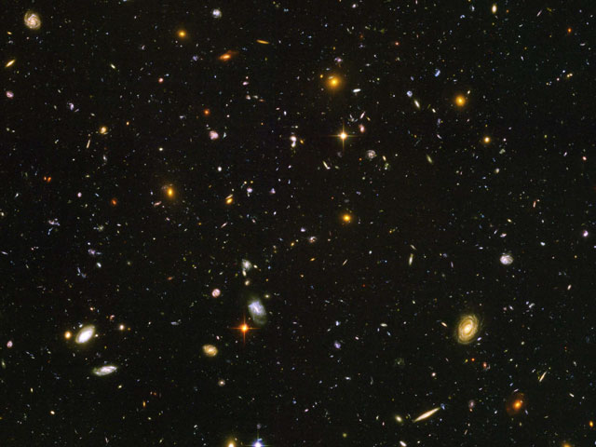
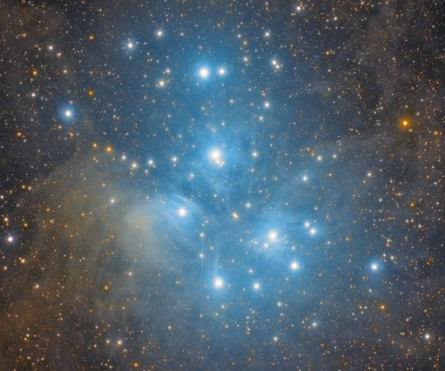
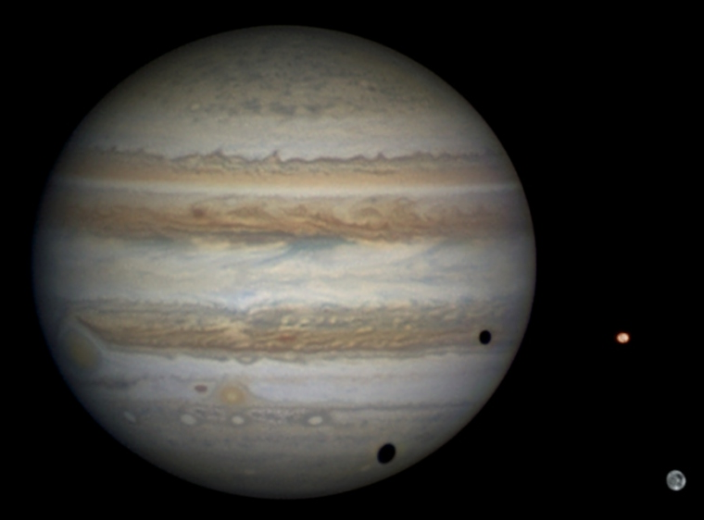
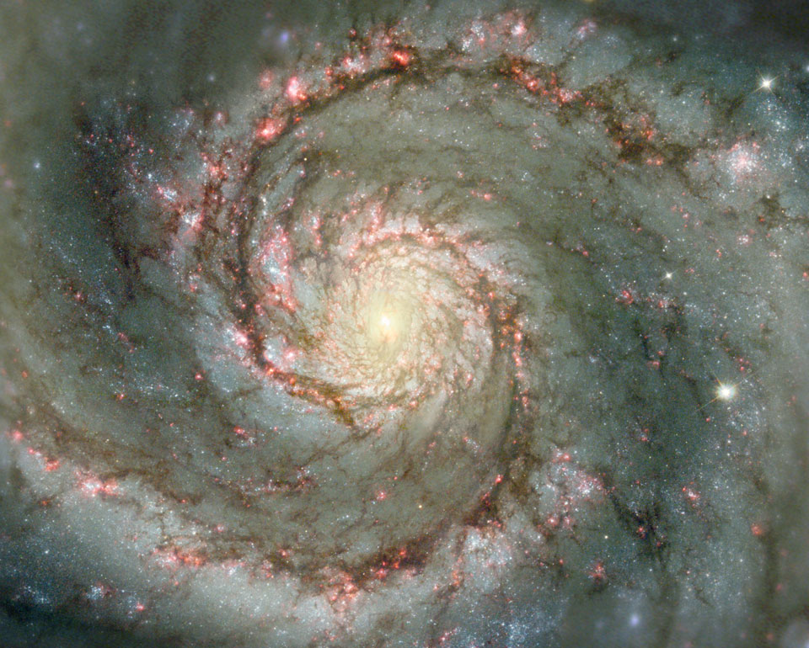
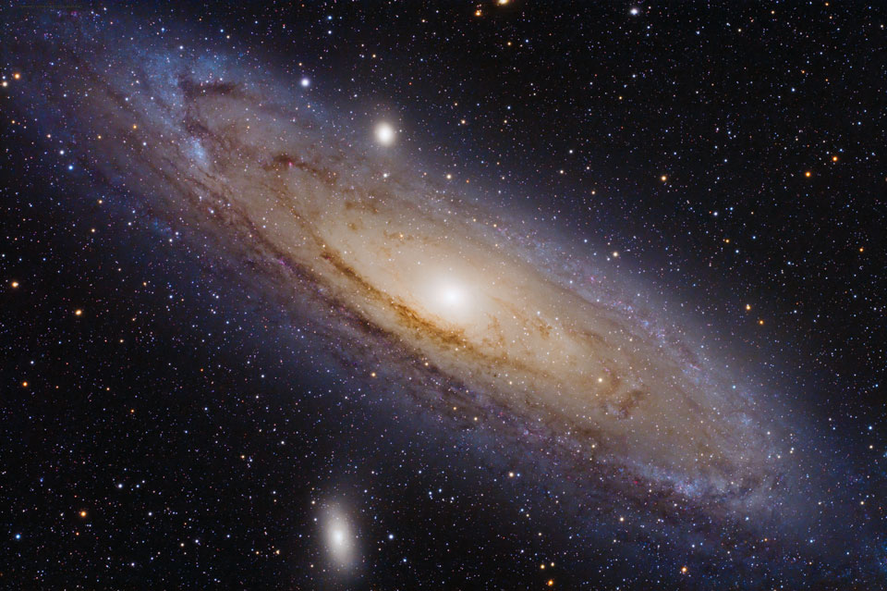
What is the Universe made of?
Galaxies
which consist of
Stars, orbited by
Planets (rocky or gaseous), orbited by
Moons
Plus comets, meteoroids etc.

Slide 3
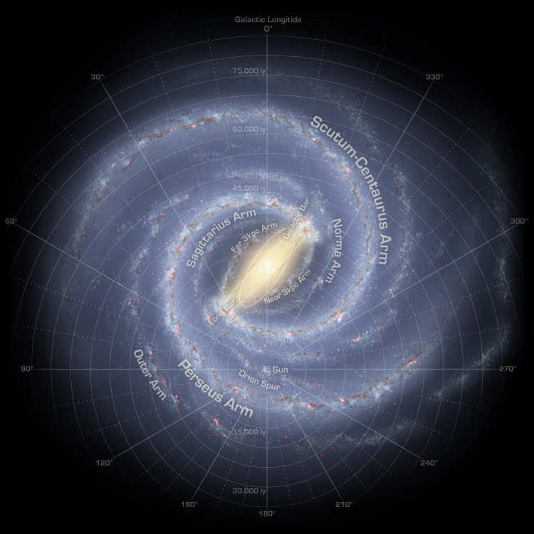
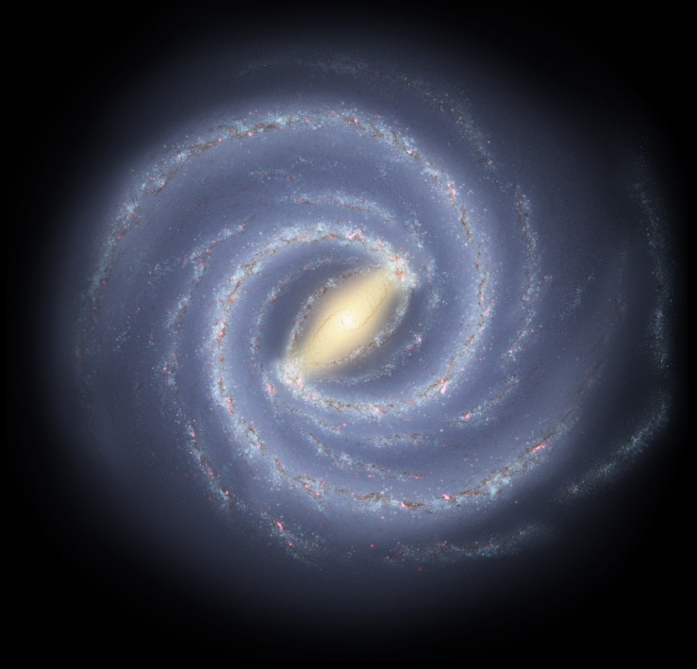
Our own galaxy

Slide 4
What’s it all made of?
Overall:
Constituent | WMAP results (2003) | Planck results (2013)
Baryonic matter | 4% | 4.8%
Dark matter | 23% | 25.8%
Dark Energy | 73% | 69.4%

Slide 5
Distance units
Why not just use metres?
New units:
  Astronomical Unit (AU)
    = the average distance from Earth to the Sun
  Light-year (ly)
    = distance travelled by light in one year
  Parsec (parallax-second, pc)
    Slightly less obvious!

Slide 6
Conversions
Unit | in metres: | in AU: | in ly: | in pc:
AU | 1.496… × 10¹¹ | 1 | 1.58 × 10⁻⁵ | 4.85 × 10⁻⁶
ly | 9.461… × 10¹⁵ | 63240 | 1 | 0.307
pc | 3.086… × 10¹⁶ | 2.06 × 10⁵ | 3.26 | 1

Slide 7
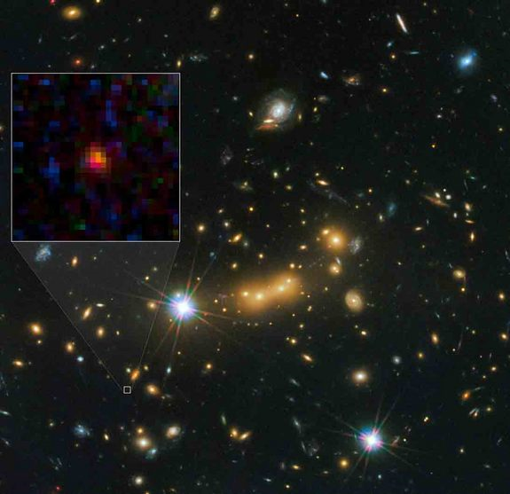
Furthest object from the Earth?
Latest contender is Galaxy MACS0647-JD, whose distance was measured in 2012 as 13.3 × 10⁹ ly
Express this in Mpc and metres
  4300 Mpc
  1.26 × 10²⁶ m

Slide 8
Stellar Evolution
Birth, Life and Death

Slide 9
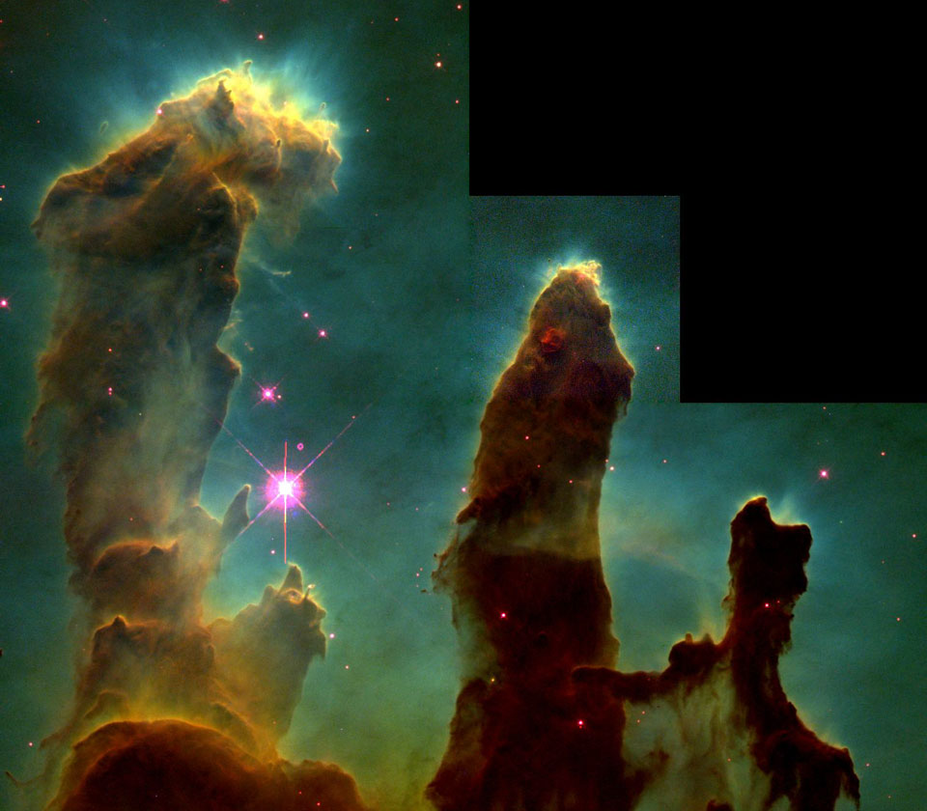
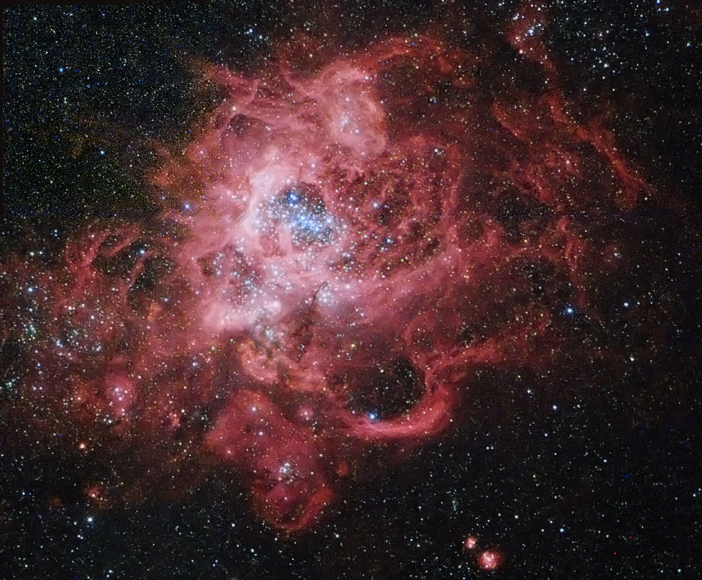
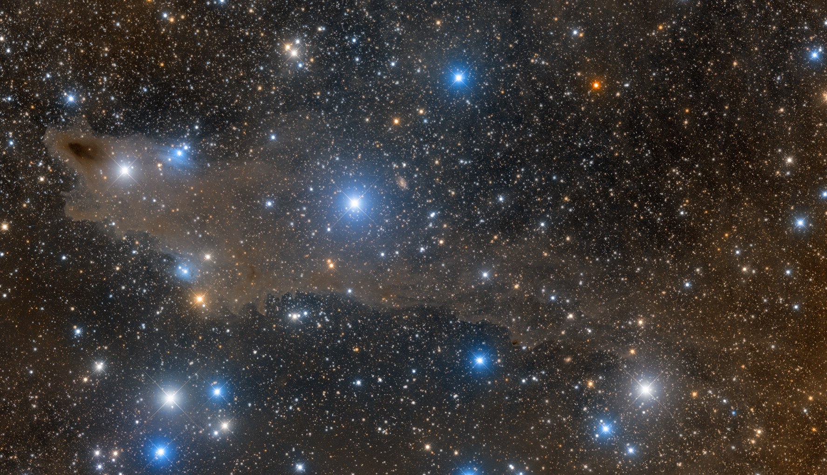
Birth
Stars form in clouds of gas and dust called nebulas:

Slide 10
The process starts
A shock wave or other disturbance causes the atoms to gravitationally collapse
As the gas and dust accumulates, its mass increases, causing further material to be attracted
As the material accelerates inward, it loses GPE which is transferred to KE, heating the shrinking ball of gas (protostar)
The star starts to emit IR and eventually visible light
The protostar is seen as a ‘brown dwarf’

Slide 11
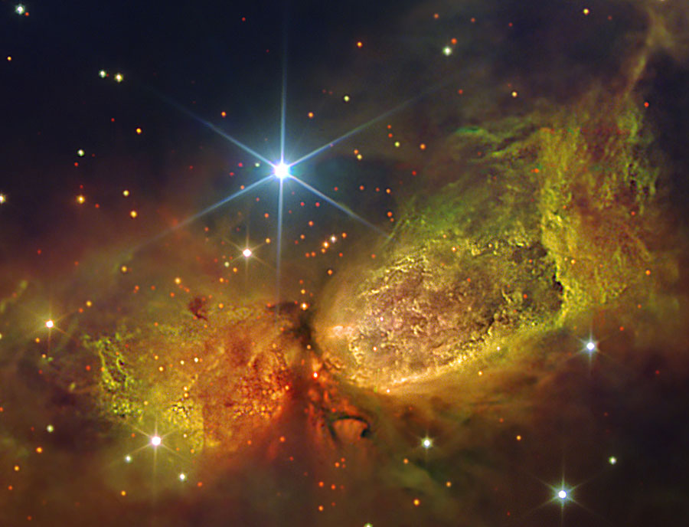
Brown Dwarfs
Hundreds of brown dwarfs have been found in the gas of this nebula:

Slide 12
Eventually…
As the protostar/brown dwarf accumulates material, the temperature and pressure in its core increases
If it can pull in enough gas and dust (M > 0.08M☉), T and p can increase to the point where nuclear fusion begins
It is now ‘officially’ a star
Heat and light output increase (relatively) suddenly, and much of the remaining dust and gas is driven off

Slide 13
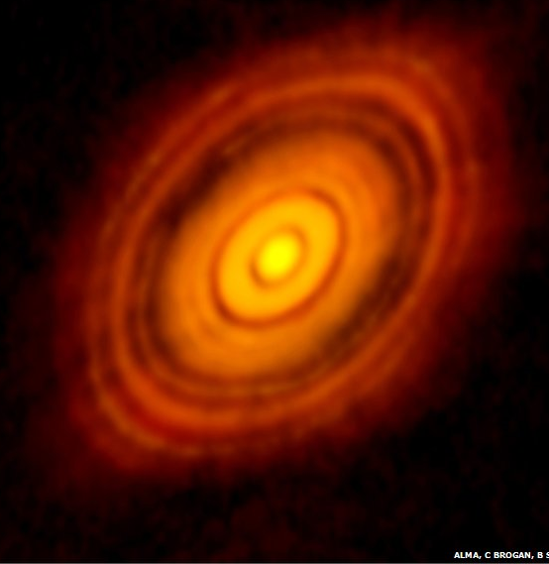
Planet formation
The remaining material then slowly clumps together gravitationally, forming planets, moons etc.
Lighter elements are driven further away, hence outer planets tend to be gaseous, inner planets rocky
Notes:
Actual radio telescope (ALMA) picture of planets forming and sweeping out paths in the debris. http://www.bbc.co.uk/news/science-environment-29932609

Slide 14

Criterion for collapse
A cloud of radius R and total mass M will collapse if the GPE of a particle (of mass m) on its edge is greater than its vibrational energy:
$$\frac{GMm}{R}>\frac{3}{2}kT$$
So minimum mass (= Jeans mass = M_{J}) will be:
$$M_{\text{J}}=\frac{3kTR}{2Gm}$$

Slide 15

Making the Sun
$$M_{\text{J}}=\frac{3kTR}{2Gm}$$
Calculate the maximum radius (in AU and light-years) of a cloud of Hydrogen gas at 10K which could form a one solar-mass (M☉ = $2×{10}^{30}$ kg) star
  1.07 × 10¹⁵ m = 7200 AU = 0.11 ly

Slide 16

Jeans Density
If $M_{\text{J}}=\frac{3kTR}{2Gm}$, show that the minimum density ($ρ_{\text{J}}$) necessary for a spherical cloud to undergo collapse is given by:
$$ρ_{\text{J}}=\frac{3}{4πM^{2}}{\left(\frac{3kT}{2Gm}\right)}^{3}$$
Calculate the Jeans density of the cloud that formed our Sun (assuming the cloud consisted only of Hydrogen at 15K).
  1.29 × 10⁻¹⁵ kgm⁻³
Notes:
Rearrange the given expression for R, then substitute into p=M/V, using 4/3 pi r3 for Volume and substituting for R.

Slide 17
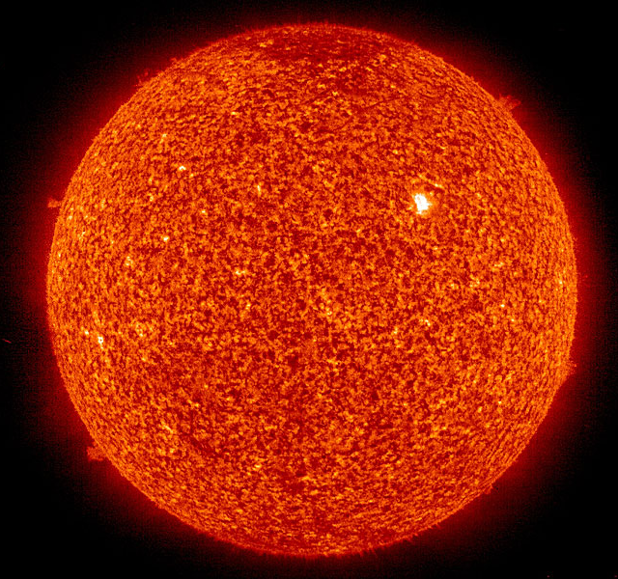
Life
The star then enters a stable period of its life
Gravity exerts an inward pressure on the star…
…which is balanced by…
…the outward pressure of the fusion

Slide 18
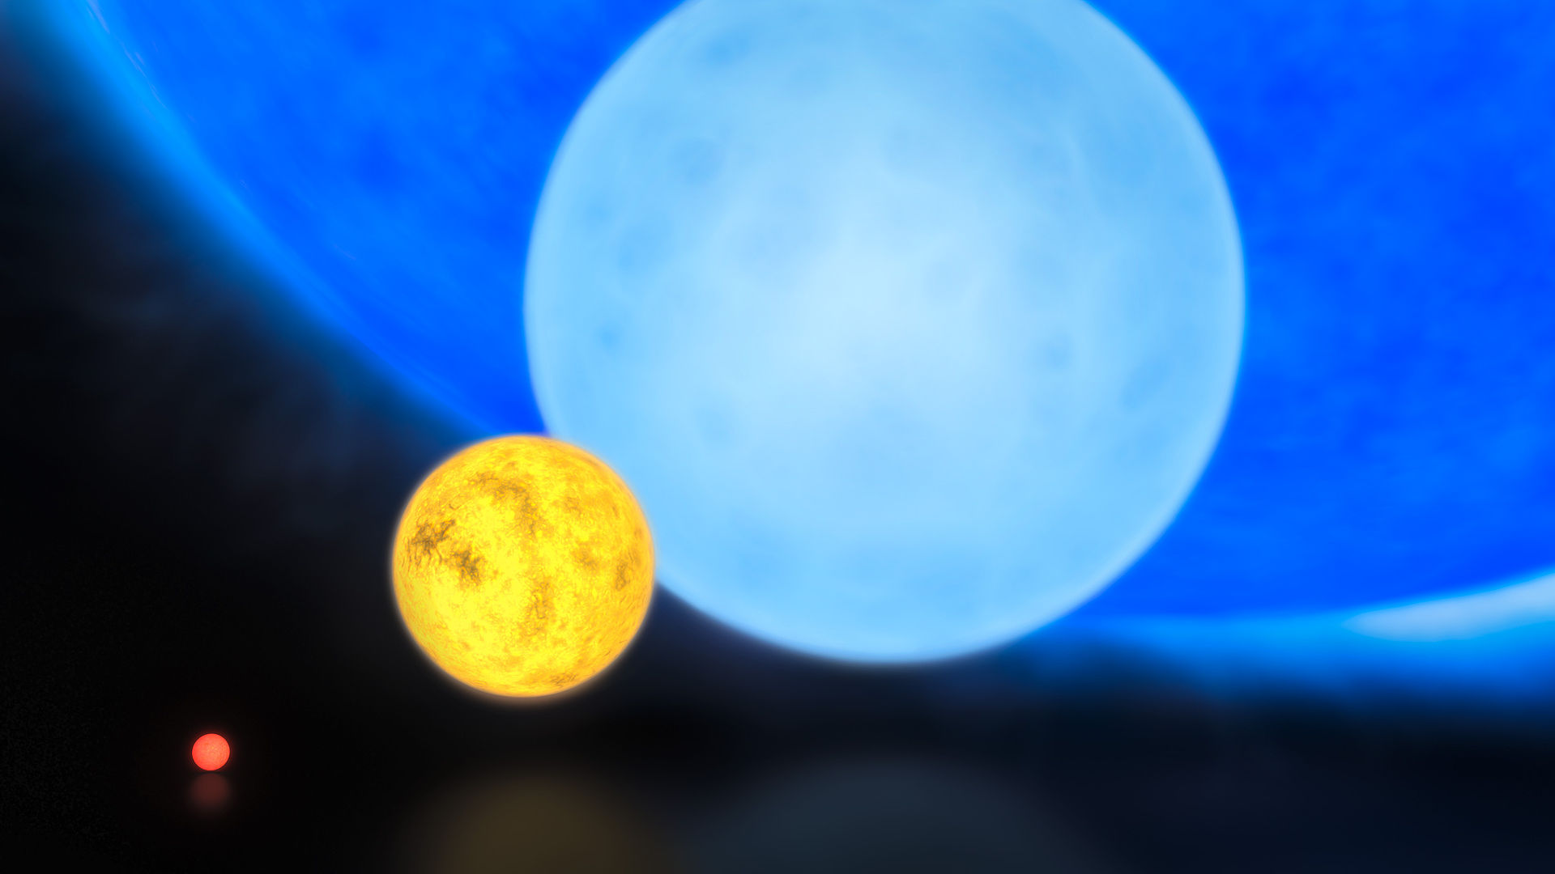
Size comparison
R136a1 (the most massive start known, M~315M☉!)
Typical B-type MS star
The Sun
Red dwarf
Notes:
L > R: a red dwarf, the Sun, a typical B-type main sequence star and R136a1 (the most massive star currently known, at ~315 solar masses, larger than the Eddington limit!)

Slide 19

Fusion in a star
Main process is called the proton-proton (p-p) chain
First, two Hydrogen nuclei fuse to form Helium-2:
  $${}_{1}^{1}{\text{H}}+{}_{1}^{1}{\text{H}}→{}_{2}^{2}{\text{H}\text{e}}+\text{Energy}$$
This then undergoes β⁺ decay to form Hydrogen-2 (Deuterium):
  $${}_{2}^{2}{\text{H}\text{e}}→{}_{1}^{2}{\text{H}+{}_{1}^{0}{{\text{e}}^{+}}+{\text{ν}}_{\text{e}}}+\text{Energy}$$
Notes:
About 83% of the Sun’s energy output comes from this version of the p-p chain. Bigger stars have a different process called the CNO cycle which dominates at higher temperatures.

Slide 20

Then…
The positron annihilates with another electron, releasing more Energy
The Deuterium fuses with another Hydrogen nucleus, making:
${}_{1}^{2}{\text{H}+{}_{1}^{1}{\text{H}}→}$ ${}_{2}^{3}{\text{He}}+\text{γ}+\text{Energy}$
Eventually, two of these Helium-3 nuclei can fuse, making:
${}_{2}^{3}{\text{H}\text{e}+{}_{2}^{3}{\text{H}\text{e}}→}$ ${}_{2}^{4}{\text{He}}+2{}_{1}^{1}{\text{H}}+\text{γ}+\text{Energy}$

Slide 21
How often does this happen?
The Sun emits a total of 3.85 × 10²⁶ W
The majority of this Energy comes from the p-p chain, which releases a net 26 MeV per chain
Show that 9.3 × 10³⁷ p-p chains happen in the Sun per second

Slide 22
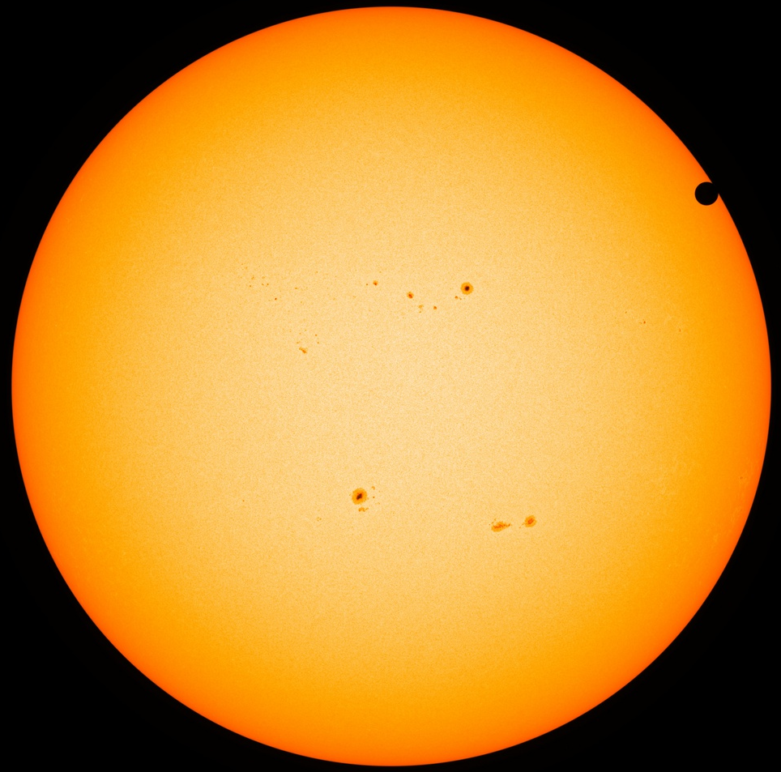
The more massive the star, the higher the T and p in the core…
…so the faster fusion occurs…
…so the brighter and hotter (bluer) the star is…
…but the shorter its life

Slide 23
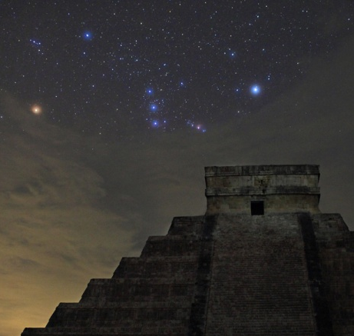
Types of stable star
Small = red
Medium = yellow
Large = blue

Slide 24
Hertzsprung-Russell Diagrams
A scatter graph where stars are plotted based on their surface temperature and brightness (luminosity)
Both scales are logarithmic
Luminosity is usually given in solar units (i.e. 1 = the luminosity of the Sun)
Temperature in Kelvin, but on a reversed scale
  for historical reasons, which you are welcome to Google for yourself

Slide 25
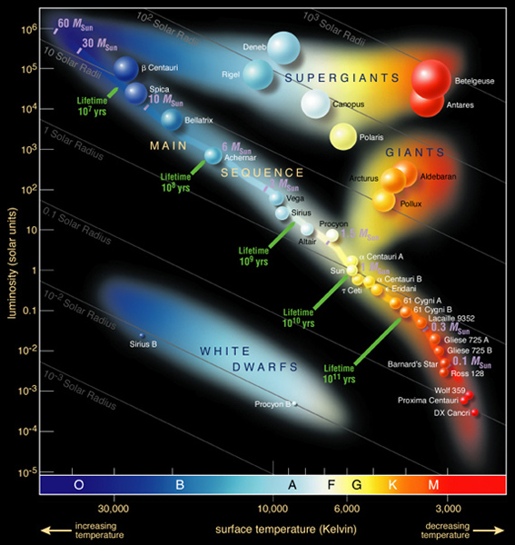

Slide 26
Stars migrate around an H-R diagram during their lives
For example, it would have taken our Sun about 20-30 million years to reach its current stable place on the main sequence

Slide 27
Changes during the life of a star
Since H fuses to He, the density of a star during its lifetime must go up
This produces more inwards gravitational pressure
Which increases the rate of fusion
Our Sun is getting 10% brighter every 10⁹ years
In 2 × 10⁹ years from now, all water on Earth will have evaporated
In 3 × 10⁹ years from now, all life on Earth will be gone

Slide 28
Death
Eventually, all stars start to run out of fuel in their cores
This means the outward pressure decreases
This results in the star expanding
Does that seem right?

Slide 29

Why?
With less outward pressure, the core shrinks
This increases the T & p in the core
Which increases the star’s energy output
Which causes the outer layers to expand (and cool to a redder colour)

Slide 30
Next
What happens now depends on the star’s mass:
1.4 M☉ is known as the Chandrasekhar limit
Total star mass (M☉) | Core mass (M☉) | Fate
< 8 | < 1.4 | Red Giant, then (White Dwarf + planetary nebula)
8 to 20 | 1.4 to 3 | Red supergiant then Supernova, then Neutron Star
> 20 | > 3 | Red supergiant then Supernova, then Black Hole

Slide 31
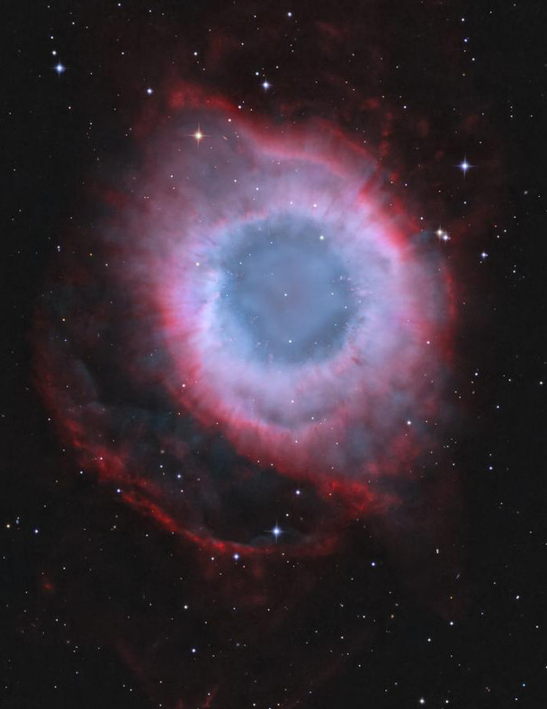
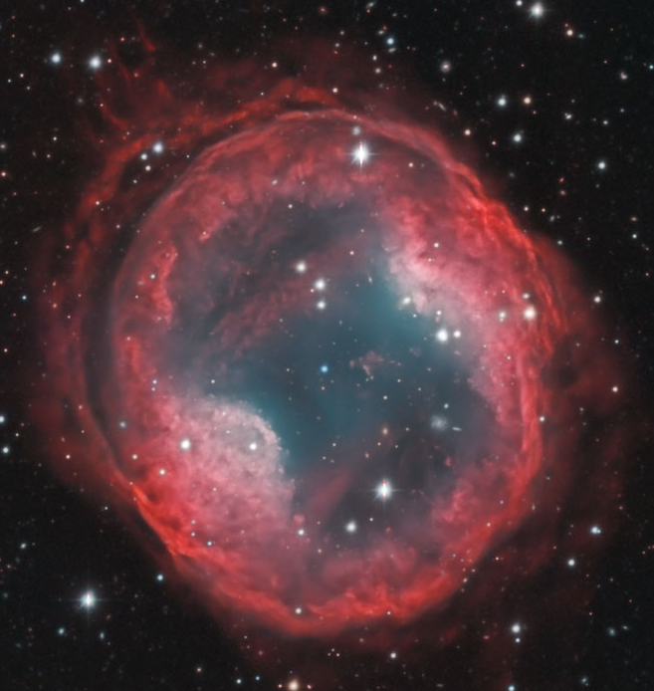
Low-mass stars (M < 8 M☉)
The core (M_{core} < 1.4 M☉) shrinks to become a white dwarf star
The outer layers expand and cool to Red Giant size, possibly swallowing some of its planets
Eventually is seen as a planetary nebula

Slide 32
Brightness of Red Giants
As the Sun expands to become a giant star, it too will cool to become red
You might therefore expect a red giant to be dimmer than it was before expansion started
Actually, they move up on an H-R diagram, meaning they become brighter. Why?
  Lower T, but greater surface area, so higher total energy output

Slide 33
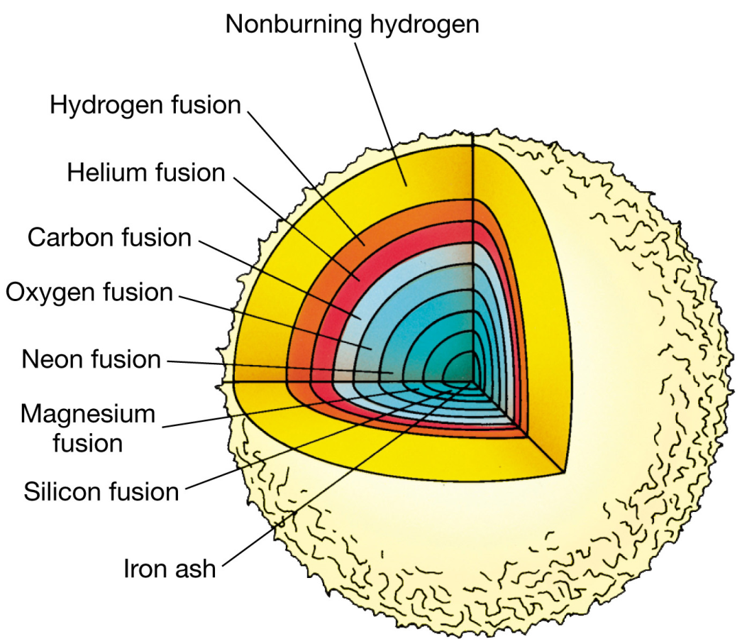
Large heavy stars (M ≈ 8-20 M☉)
Core has already fused elements up to Mg due to high T & p
T & p increase deeper in the core, meaning heavier elements can fuse: ‘onion layers’
Process stops at ⁵⁶Fe. Why?

Slide 34
Timing
The process accelerates:
  H fusion: ~10⁹ y
  He fusion: ~10⁶ y
  C fusion: ~10³ y
  Ne, O fusion: ~1 y
  Si fusion: ~1 day

Slide 35
Eventually (in a matter of seconds)…
The fusion slows down, and collapse accelerates in the absence of the outward forces
Nuclei heavier than ⁵⁶Fe are formed
Photons rip apart atoms to create a ‘soup’ of p, n, e and γ
As the core implodes, the quantum degeneracy pressure (due to Pauli exclusion principle) is overcome and:
e⁻ + p → n + ν_{e}

Slide 36
Supernova
Intense neutrino flux and force of rebounding core blasts outer layers off in a supermassive explosion called a supernova
E ~ 10⁴⁴ J
  cf. largest ever hydrogen bomb explosion ~ 10²⁰ J
Event can be seen in distant galaxies

Slide 37
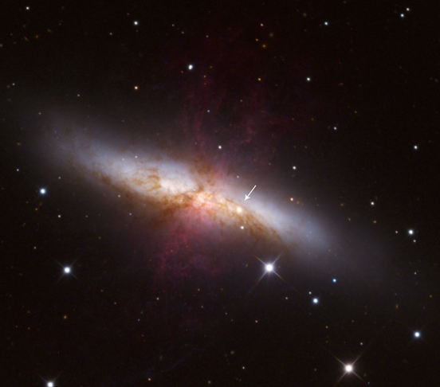
21st January 2014
Supernova seen in galaxy M82, 12 million light-years away
  Actually a type Ia SN (caused by the explosion of a white dwarf after accreting enough matter from a companion star)

Slide 38
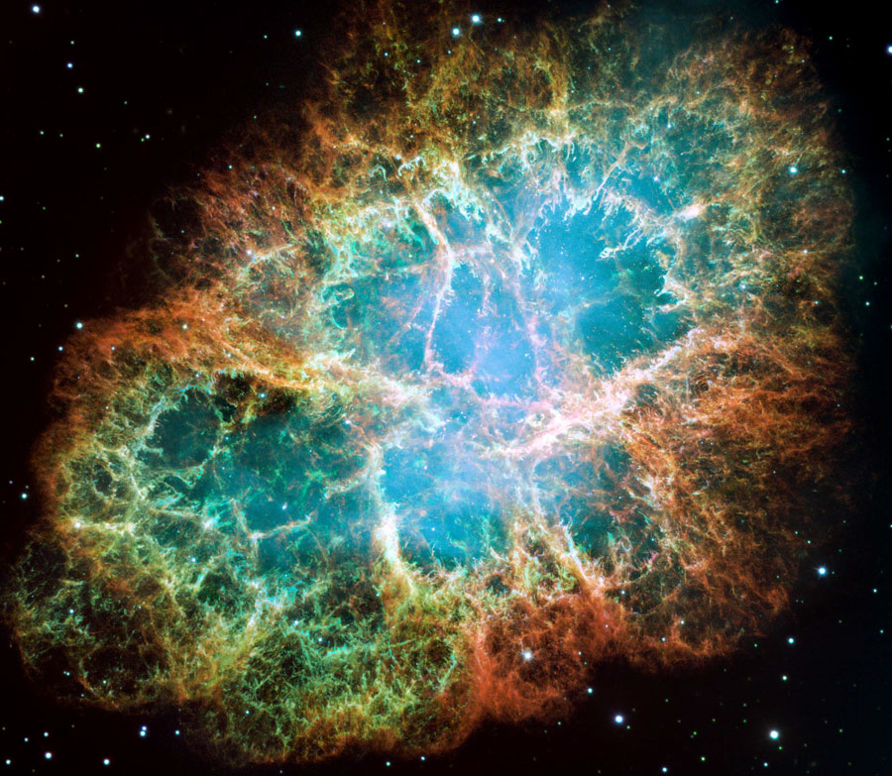
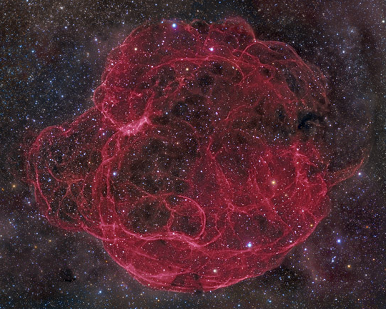
Supernova remnants
Notes:
Simeis 147 (40 000 ly away)

Slide 39
Crab Nebula expansion
Images taken over a decade apart:
vimeo.com/71117055

Slide 40
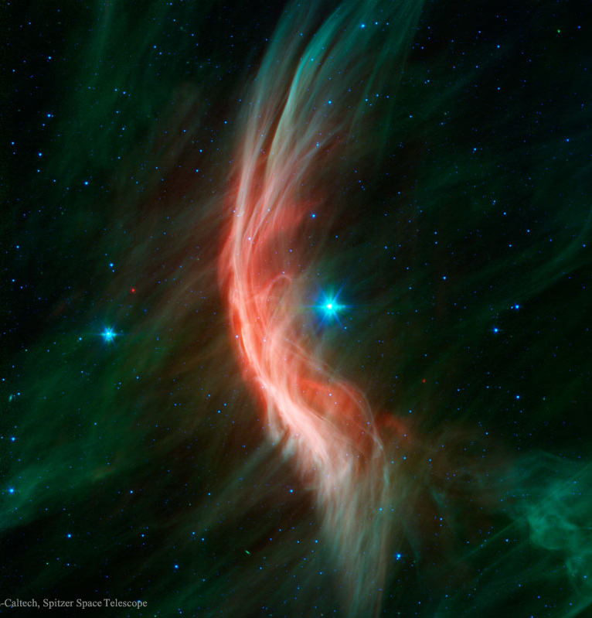
What about in Binary systems?
This is a 20 M☉ star travelling at 24 kms⁻¹ (!), forming a bow shock wave as it passes through a gas cloud
Show that KE ~ 10⁴⁰ J
Thought to be a former binary partner of a star which went supernova, pushing it out into space
Notes:
http://apod.nasa.gov/apod/ap150705.html

Slide 41
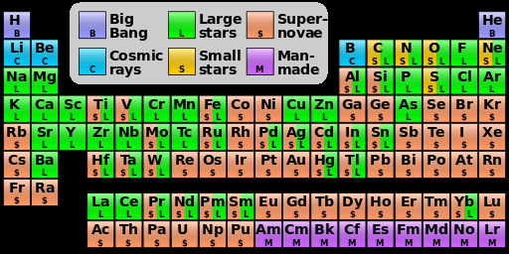
Nucleosynthesis summary

Slide 42
What happens to the core?
Protons and electrons have merged to become neutrons
Since they neither attract nor repel each other, nearly all of the space around them is occupied, unlike in atoms
Density is enormous: ~10¹⁷ kgm⁻³
  cf. ~10⁴ kgm⁻³ for atomic substances (e.g. Pb, Au)
What sort of gravitational field strength would this create?

Slide 43

g on a neutron star
A 20 solar mass neutron star would only have a 20km diameter
Calculate g on the surface of such a star, and compare it to 9.81 Nkg⁻¹
  M☉ = $2×{10}^{30}$ kg
$$g=\frac{GM}{r^{2}}$$
$$=\frac{6.67×{10}^{−11}×20×2×{10}^{30}}{{(10×{10}^{3})}^{2}}$$
$$=2.7×{10}^{13} {\text{Nkg}}^{−1}$$

Slide 44

suvat on a neutron star
If you dropped your pen on a neutron star, 1m above its surface, how long would it take to hit the ground?
  2.7 $×$ 10⁻⁷ s
What speed would it hit the surface at?
  7.3 $×$ 10⁶ ms⁻¹

Slide 45
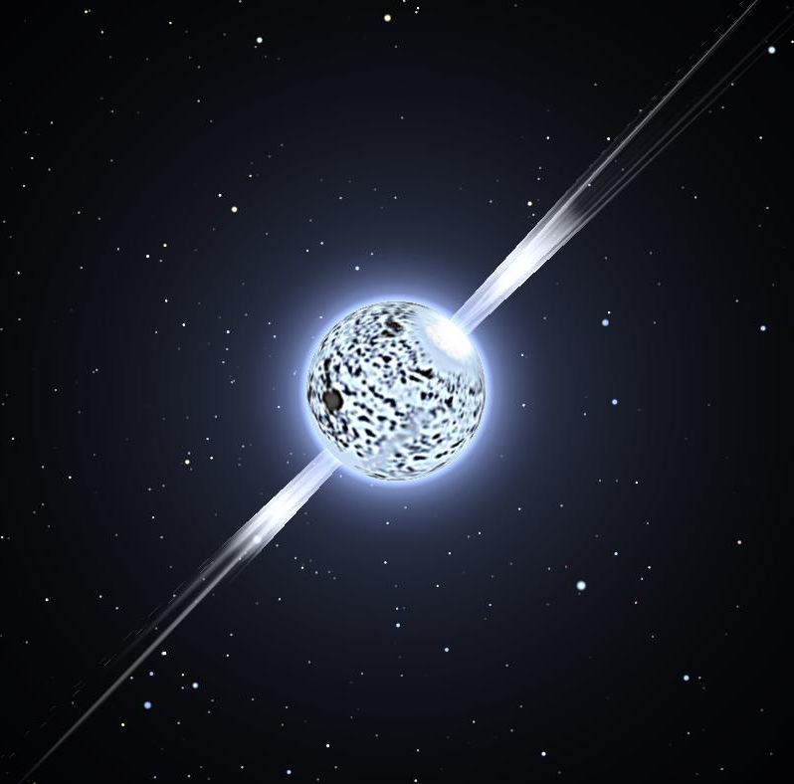
Can we detect neutron stars?
The implosion leaves the star spinning very fast
For reasons we don’t fully understand, it emits coherent beams of very high energy radio waves from the poles
In the 1960s, radio telescopes on Earth detected very precisely periodic radio wave emissions
Originally called LGM, then pulsars, but was quickly realised that they were neutron stars

Slide 46
Superheavy stars (M > 20 M☉)
Collapse proceeds as before, causing a supernova
Neutrons also have a degeneracy pressure due to the exclusion principle, which can also be overcome under conditions even more extreme than in a neutron star
In the largest stars, the gravitational collapse is unstoppable and the core collapses to a singularity

Slide 47
Black Hole
The singularity’s density is so huge that its gravitational field is even stronger than a neutron star’s
Not even light (or any other e-m radiation) can escape

Slide 48

Escape velocities
$v_{\text{esc}}$ is the minimum velocity an object needs to completely escape another object’s gravitational field
Prove that $v_{\text{esc}}=\sqrt{\frac{2GM}{r}}$
For $v_{\text{esc}}=c$, an object must be compressed to less than its Schwarzschild radius (R_{S})
Show that $R_{\text{S}}=\frac{2GM}{c^{2}}$
Calculate R_{S} for the Earth

Slide 49
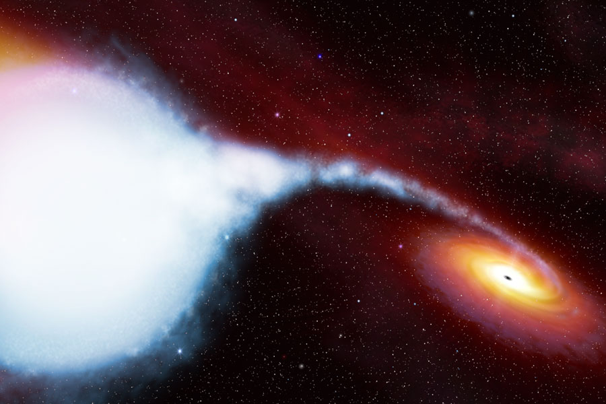
Observational evidence
BHs, by definition, emit nothing
  (apart from hypothetical Hawking Radiation)
so observing them ‘is an issue’
1972: X-rays observed from Cygnus X-1
Best explanation is that material is being ripped off its accompanying supergiant star and emits X-rays as it accelerates into a BH

Slide 50
SMBHs at the centres of galaxies
In 2002, evidence found that the object at the centre of the Milky Way has properties consistent with being a SMBH
M > 4 × 10⁶ M☉
SMBHs have been found at the centres of almost all galaxies, up to ~ 4 × 10⁹ M☉ !!
SMBHs consistently have mass ~1000 times mass of the parent galaxy
  are SMBHs crucial to galactic formation/evolution?

Slide 51
BHs at centres of galaxies
http://apod.nasa.gov/apod/ap120702.html
http://www.eso.org/public/videos/eso0846f/
http://www.eso.org/public/videos/eso1151c/

