Slide 1
The Earth,
the Moon
and Tides

Slide 2
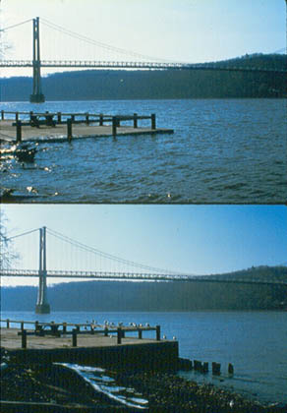
What causes the Tides?
All coastlines on the Earth show a rise and fall in water level approximately twice a day
Size of tide varies hugely, and local geography makes an enormous difference
Why does this happen?

Slide 3
The Earth and Moon
The Moon is unusually massive for a satellite
  M_{Moon} = 1.2% M_{Earth}; M_{Ganymede} = 0.008% M_{Jupiter}
The Moon’s gravitational field is large enough to influence the large body of water on the Earth:
Water
Moon
Earth

Slide 4
Starting simply…
Clearly, the Moon’s gravity will attract the water to it:
Why does this not describe reality accurately enough?
There are TWO high tides per day!
High Tide
Low Tide

Slide 5
More accurately:
In fact, the Moon’s gravity will also attract the Earth towards it more strongly than the water on the far side of the Earth:
This is much closer to reality, and is as far as most A-level textbooks go
Strongest F
Weaker F
Weakest F

Slide 6
What about rotation effects?
The Moon goes around the Earth once every …
The Earth spins on its own axis once every …
The Earth’s rotation drags the tidal bulge around with it due to friction
29.5 days
24 hours

Slide 7
So what?
What effect will the tidal bulge now have on the Moon?
The tidal bulge therefore will speed the Moon up, which will…
put it into a higher orbit!
Notes:
The tidal bulges on Earth are carried ahead of the Earth–Moon axis by a small amount as a result of the Earth's rotation. This is a direct consequence of friction and the dissipation of energy as water moves over the ocean bottom and into or out of bays and estuaries. Each bulge exerts a small amount of gravitational attraction on the Moon, with the bulge closest to the Moon pulling in a direction slightly forward along the Moon's orbit, because the Earth's rotation has carried the bulge forward. The opposing bulge has the opposite effect, but the closer bulge dominates due to its comparative closer distance to the Moon. As a result, some of the Earth's rotational momentum is gradually being transferred to the Moon's orbital momentum, and this causes the Moon to slowly recede from Earth at the rate of approximately 38 millimetres per year. In keeping with the conservation of angular momentum, the Earth's rotation is gradually slowing, and the Earth's day thus lengthens by about 17 microseconds every year. (This would make each Earth day one second longer every 60,000 years or so, and one minute longer every four million years). Looking back, the day was a mere 23 hours in length when the dinosaurs roamed the Earth 65 million years ago.) See tidal acceleration for a more detailed description and references.

Slide 8
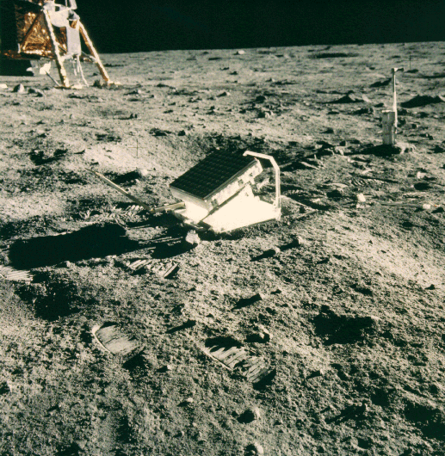
I bet it’s not measurable!
Oh yes it is!
The Apollo missions placed three retroreflector arrays on the Moon, and laser ranging has been carried out ever since
The Moon is receding from the Earth by 3.8 cm per year

Slide 9
What about the Earth?
The huge forces of tidal friction also slow down the Earth by 17 μs per year
How long was a day for the dinosaurs, 65 million years ago?
Eventually, these two effects will lead to a spin-orbit resonance between the Earth and Moon: the Earth will rotate once on its axis every 47 days, as will the Moon
The Moon will then always be above the same point on Earth
Notes:
The Moon is gradually receding from the Earth into a higher orbit, and calculations suggest that this will continue for about fifty billion years. By that time, the Earth and Moon will become caught up in what is called a "spin–orbit resonance" in which the Moon will circle the Earth in about 47 days (currently 29 days), and both Moon and Earth will rotate around their axes in the same time, always facing each other with the same side. Beyond this, it is hard to tell what will happen to the Earth–Moon system, considering that the Sun is expected to become a red giant in approximately five billion years.
Historical evidence
This mechanism has been working for 4.5 billion years, since oceans first formed on the Earth. There is geological and paleontological evidence that the Earth rotated faster and that the Moon was closer to the Earth in the remote past. Tidal rhythmites are alternating layers of sand and silt laid down offshore from estuaries having great tidal flows. Daily, monthly and seasonal cycles can be found in the deposits. This geological record is consistent with these conditions 620 million years ago: the day was 21.9±0.4 hours, and there were 13.1±0.1 synodic months/year and 400±7 solar days/year. The length of the year has remained virtually unchanged during this period because no evidence exists that the constant of gravitation has changed. The average recession rate of the Moon between then and now has been 2.17±0.31 cm/year, which is about half the present rate.

