Slide 1
How the eye works
Actually, the eye has three different types of cone cell
L cells respond to red light, M to green and S to blue
When light hits any cone cell, a pigment on the back of the retina converts it to an electrical signal to go to the brain
However, the pigment can run out after time…

Slide 2
Playing tricks on your cones
The next slide has a slightly odd image on it
There is a small red dot at the centre of the image
Stare at the red dot without moving your eyes
After 20 seconds, the slide will automatically change
Keep staring at the screen throughout
Ready…

Slide 3


Slide 5
Why does that happen?
Cyan is a mixture of blue and green light
If you stare at cyan for long enough, the green and blue-sensitive cones in your eye run out of pigment
When white light (red + green + blue) then hits your eye, only the red-sensitive cones have any pigment left to send a signal to your brain
So your brain only receives the red information
Similar argument for the yellow areas being seen as blue and magenta as green
Notes:
L cones’ peak response = 560nm, M cones = 530nm, S cones = 430nm. L cones’ peak response is not actually terribly strong in the red region, but most people have more L cones than M and S, so the total input to the brain is higher.

Slide 6
Here comes another one…

Slide 7
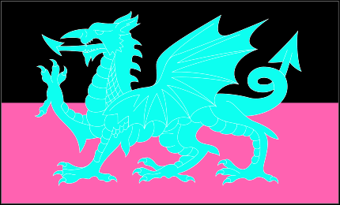

Slide 9
And now for something similar but slightly different…

Slide 10
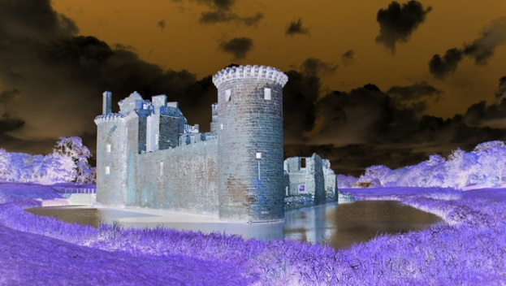

Slide 11
