Slide 1
Particle Physics

Slide 2
Physics Fundamentalism
Particle Physics is our latest attempt to find the ultimate nature of all things
‘Fundamental/elemental’ = something which cannot be broken down into anything smaller or more basic
So, an atom is not a fundamental or elementary entity, but an electron is (as far as we currently know)

Slide 3

New Ideas & Definitions
Mass units
  Expressed in terms of the energy required to create that particle
  GeV/c² or MeV/c² or keV/c²
  Nearly always written (lazily) as GeV or MeV or keV
  Show that an electron has a rest mass of 0.51 MeV/c²
Charge units
  e = 1.6 × 10⁻¹⁹ C
Spin
  Units of ħ = $\frac{h}{2π}$ (‘h-bar’)
  (helpful when considering frequencies in rad s⁻¹, not revolutions s⁻¹)

Slide 4
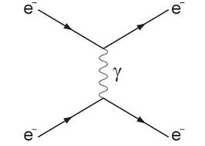
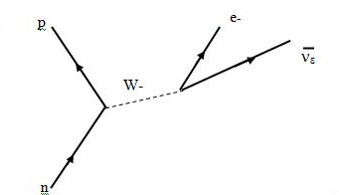
Exchange particles
Exchange Particles
  Virtual particles!
  Used to model mathematically, but cannot be observed directly
Called Gauge Bosons:
  Gluon (g)
  Photon (γ)
  W⁺, W⁻ and Z⁰
  Higgs
  Mesons (see later)
  Graviton (theoretical)

Slide 5
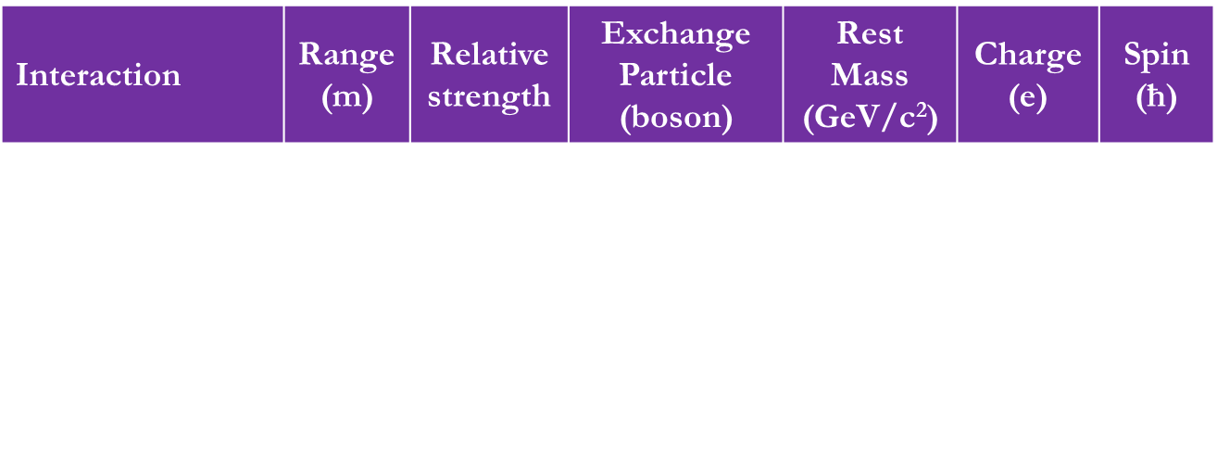
Fundamental Forces (interactions)
Think of any force. A book pushing on a desk?
What is the fundamental cause of that force?
How many fundamental forces are there?
Interaction | Range (m) | Relative strength | Exchange Particle (boson) | Rest Mass (GeV/c²) | Charge (e) | Spin (ħ)
Strong | ~10⁻¹⁵ | 1 | Gluon (pion) | 0 | 0 | 1
Electromagnetic | ∞ | $$1/{137}$$ | Photon | 0 | 0 | 1
Weak | ~10⁻¹⁸ | 10⁻⁹ | W± Z⁰ | 80.4 91.2 | ±1 0 | 1
Gravitational | ∞ | 10⁻³⁸ | Graviton? | 0? | 0? | 2?
Notes:
Pion is only the mediator of the residual nuclear force, which binds p and n to form nuclei. The gluon only binds quarks together to form nucleons. Since nucleons are therefore colour-neutral, another particle must mediate the force between nucleons. For more details, see http://hyperphysics.phy-astr.gsu.edu/hbase/forces/funfor.html and https://en.wikipedia.org/wiki/Nuclear_force

Slide 6
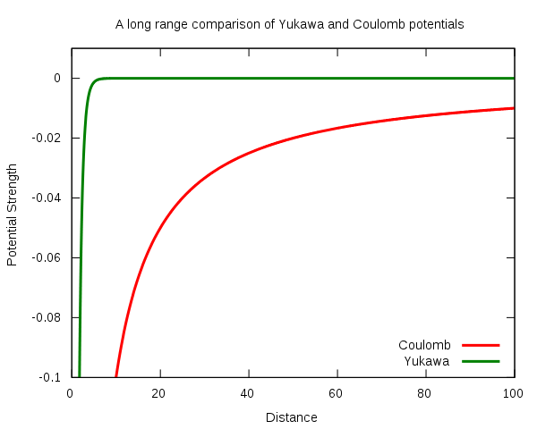
Comparing Strong and Coulomb forces

Slide 7
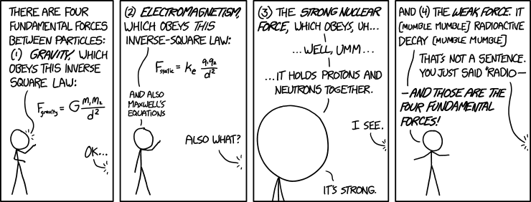
Which force do we understand least?
Answer: Gravity.

Slide 8
Unification
We would like to be able to simplify these forces and show that they are all just different aspect of one universal ‘master force’
In the 1970s, it was shown both theoretically and experimentally that the electromagnetic and weak forces combine at temperatures above ~10¹⁵ K
No further success in unification yet
Gravity is particularly problematic because it can’t be described using QM

Slide 9
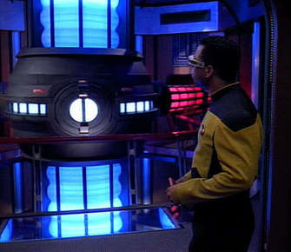
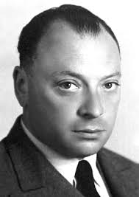

Antimatter
Not just in science fiction
In 1928, Wolfgang Pauli noticed a pair of opposite solutions from an equation
Rather like $\sqrt{9}=±3$
Would it be possible to make an electron which had a positive charge?

Slide 10

Discovery of antimatter
In 1932, Carl Anderson discovered and named positrons
He allowed cosmic rays to pass through a Lead plate and showing that particles were produced with equal but opposite charges
Electrons and positrons are notated as e ⁻ and e ⁺
Other antiparticles are notated using a bar:
  Antiproton = $\overline{p}$, antineutron = $\overline{n}$
  [antiprotons were briefly called ‘negatrons’]
Every spin-½ particle (so not bosons) has an antiparticle equivalent, with identical properties but opposite sign

Slide 11
Annihilation
If a particle collides with its antiparticle they annihilate: they are converted into energy, often in the form of photons
If an electron and positron collide, annihilate and become a pair of 0.511 MeV photons:
  Why exactly this energy?
  Why not a single photon?
  What part of the EM spectrum are they?
Calculate the energy density (in Jkg⁻¹) of this reaction
Notes:
A pair must be created to obey conservation of momentum.
During a low-energy annihilation, photon production is favoured, since these particles have no mass. However, high-energy particle colliders produce annihilations where a wide variety of exotic heavy particles are created.

Slide 12
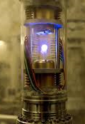

Energy densities
Food metabolism ~ 10⁷ Jkg⁻¹
Burning petrol ~ 10⁷ Jkg⁻¹
Burning Hydrogen ~10⁸ Jkg⁻¹
Nuclear fission ~10¹⁴ Jkg⁻¹
Nuclear fusion ~10¹⁵ Jkg⁻¹
Matter-antimatter annihilation = $\frac{c^{2}}{1}$ ~10¹⁷ Jkg⁻¹

Slide 13
Fundamental (elementary) particles
What is a plastic pen made of?
Polymer
Monomers/molecules
Protons
Neutrons
Electrons
Nothing (?)
Quarks
Quarks
Nothing (?)
Nothing (?)

Slide 14
Quarks
It was suggested in 1964 that protons and neutrons were each made of three elementary particles
In 1968, high-energy electrons were fired at nuclei and were found to scatter inelastically in a way consistent with p and n having an internal structure of three pointlike charges
  Similar to Rutherford’s alpha-scattering experiment giving evidence for the nucleus

Slide 15
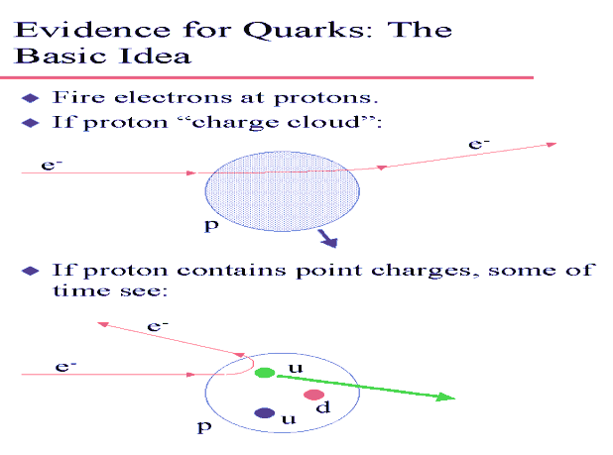

Slide 16

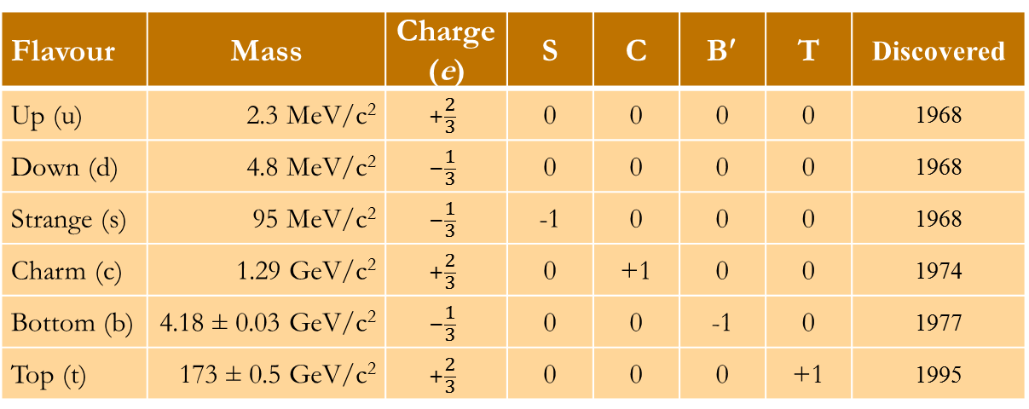
Types of quark
Initially, it was thought that there were only three types of quark (arbitrarily labelled up and down and strange)
Three more discovered since!
All have Baryon number = $\frac{1}{3}$ and spin = $\frac{1}{2}$ (so are Fermions)
Flavour | Mass | Charge (e) | S | C | B′ | T | Discovered
Up (u) | 2.3 MeV/c² | $$+\frac{2}{3}$$ | 0 | 0 | 0 | 0 | 1968
Down (d) | 4.8 MeV/c² | $$−\frac{1}{3}$$ | 0 | 0 | 0 | 0 | 1968
Strange (s) | 95 MeV/c² | $$−\frac{1}{3}$$ | -1 | 0 | 0 | 0 | 1968
Charm (c) | 1.29 GeV/c² | $$+\frac{2}{3}$$ | 0 | +1 | 0 | 0 | 1974
Bottom (b) | 4.18 ± 0.03 GeV/c² | $$−\frac{1}{3}$$ | 0 | 0 | -1 | 0 | 1977
Top (t) | 173 ± 0.5 GeV/c² | $$+\frac{2}{3}$$ | 0 | 0 | 0 | +1 | 1995
Notes:
Fermions => obey Pauli exclusion principle

Slide 17
Hadrons
A hadron is any particle made up of quarks (from the Greek ἁδρός meaning thick)
Hadrons come in two types:
  Baryons (made of 3 quarks; Greek βαρύς, heavy)
  and
  Mesons (made of 2 quarks; Greek μεσος, medium)

Slide 18

Making hadrons (part 1): Baryons
Protons and neutrons are both baryons, made up exclusively of up and down quarks
Work out what combination makes each type
  Proton = uud
  Neutron = udd
    Can you now see why neutrons are very slightly heavier than protons?
What about antiprotons and antineutrons?
  Antiproton = $\overline{u} \overline{u}$ $\overline{d}$
  Antineutron = $\overline{u} \overline{d}$ $\overline{d}$

Slide 19
More baryons
A few other examples of baryons (dozens have been observed experimentally):
What would be the Baryon number of an anti-Δ⁺⁺?
Name | Symbol | Composition | Q | B | S
Sigma + | Σ⁺ | suu
Xi 0 | Ξ⁰ | ssu
Delta ++ | Δ⁺⁺ | uuu
Sigma star 0 | Σ^{*0} | sud
Charmed lambda | Λ^{c+} | udc

Slide 20
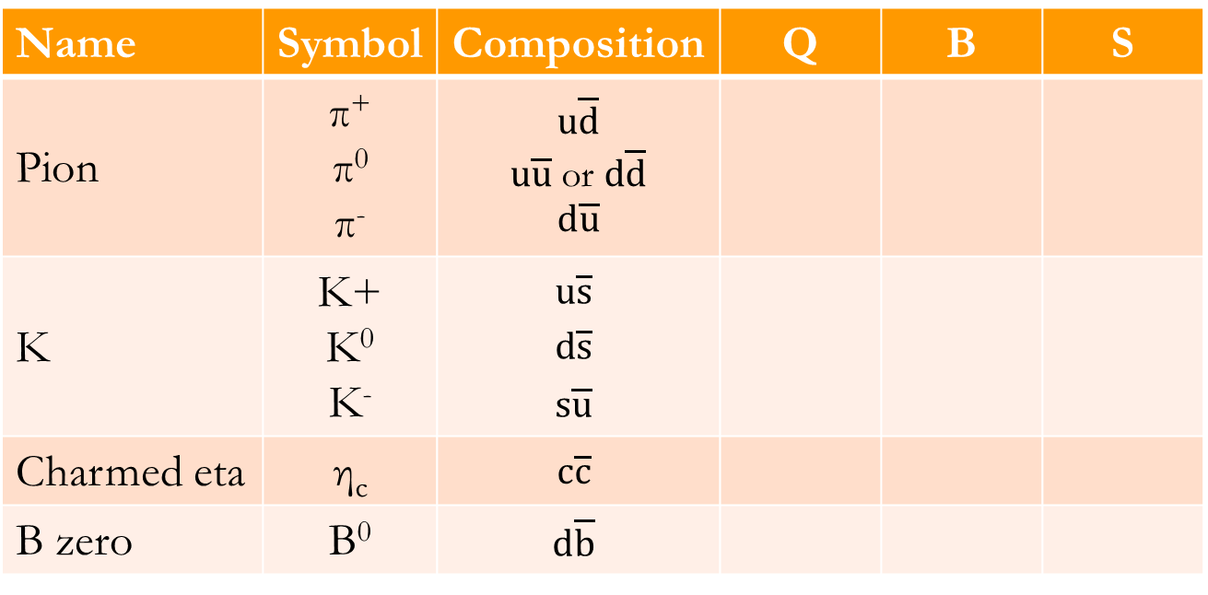
Making hadrons (part 2): Mesons
Mesons are quark-antiquark pairs
Some examples (again, dozens have been observed):
Name | Symbol | Composition | Q | B | S
Pion | π⁺ π⁰ π⁻ | $$u\overline{d}$$ $u\overline{u}$ or $d\overline{d}$ $$d\overline{u}$$
K | K+ K⁰ K⁻ | $$u\overline{s}$$ $$d\overline{s}$$ $$s\overline{u}$$
Charmed eta | η_{c} | $$c\overline{c}$$
B zero | B⁰ | $$d\overline{b}$$

Slide 21

Quark combinations
Single quarks are never observed
A quark-antiquark pair is called a meson
A trio of quarks is called a baryon
Is it possible to make hadrons made of more than three quarks?
  Tetraquark ($q\text{q}\overline{qq}$) – not possible within the standard quark model, though possibly observed in 2007
  Pentaquark ($q\text{qqq}\overline{q}$) – observed at CERN in July 2015

Slide 22
Mesons as bosons (aka ‘what binds nuclei together?’)
Gauge bosons are virtual interaction-mediating (=force-carrying) particles, e.g. W⁺
Gluons mediate the strong force between quarks to form protons and neutrons
They cannot directly bind p and n together to form nuclei because p and n are colour-neutral
However, some of the strong interaction ‘leaks out’ to bind the p and n together
This residual strong force is mediated by virtual mesons rather than gluons
In general, though, mesons would not normally be considered as bosons

Slide 23

Conservation Laws
You already know about conservation of energy, momentum and charge – these are exact and have never been seen or proven to be violated
Baryon number, strangeness and other ‘flavour quantum numbers’ were suggested/invented to explain why some reactions were never seen:
    e.g. $p+\overline{p}→n+\overline{n}$ is seen
    but
    $p+\overline{p}→n+n$ is never seen
Why not?

Slide 24
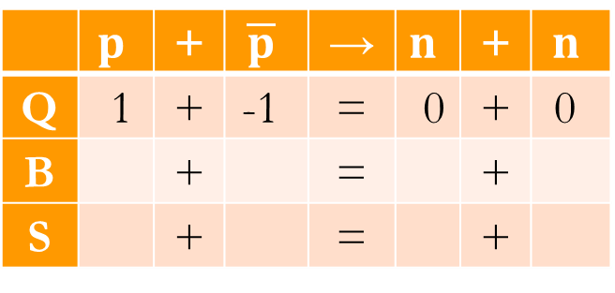
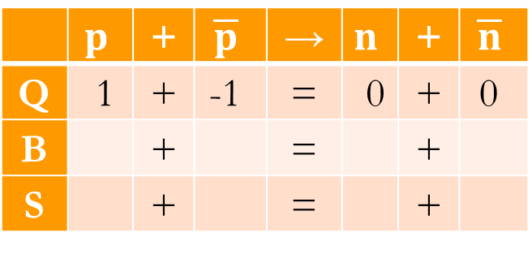
 | $$p$$ | + | $$\overline{p}$$ | → | $$n$$ | + | $$\overline{n}$$
Q | 1 | + | -1 | = | 0 | + | 0
B |  | + |  | = |  | +
S |  | + |  | = |  | +
 | $$p$$ | + | $$\overline{p}$$ | → | $$n$$ | + | $$n$$
Q | 1 | + | -1 | = | 0 | + | 0
B |  | + |  | = |  | +
S |  | + |  | = |  | +

Slide 25
It seems that Baryon number always has to be conserved in particle reactions (with the exception of the chiral anomaly)
Similar laws seem to apply consistently to other flavour quantum numbers in strong and e-m (but not weak) interactions:
  Conservation of Strangeness
  Conservation of Bottomness
  etc.

Slide 26
Is that it, then?
A hadron is any particle made of quarks
So what is an electron?

Slide 27
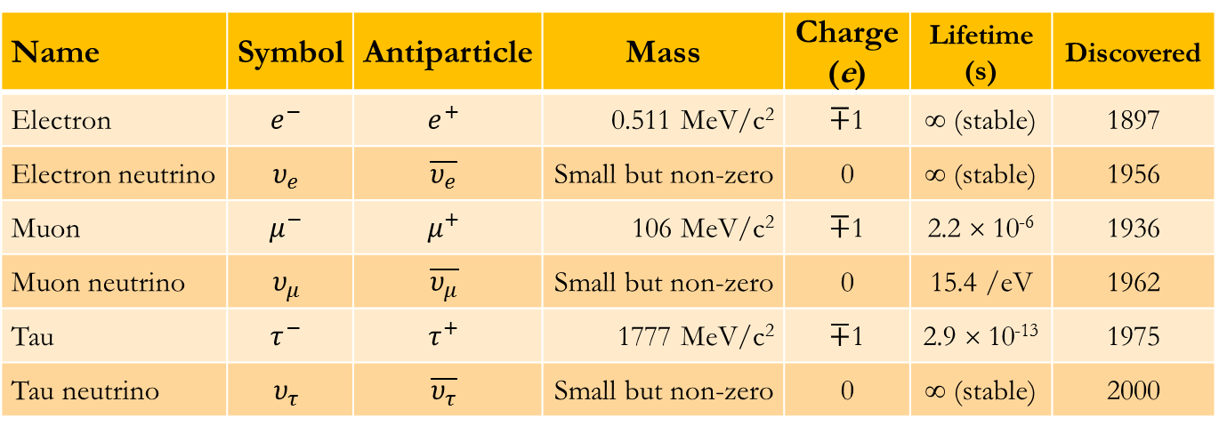

Leptons
Name | Symbol | Antiparticle | Mass | Charge (e) | Lifetime (s) | Discovered
Electron | $$e^{−}$$ | $$e^{+}$$ | 0.511 MeV/c² | $∓$1 | ∞ (stable) | 1897
Electron neutrino | $$υ_{e}$$ | $$\overline{υ_{e}}$$ | Small but non-zero | 0 | ∞ (stable) | 1956
Muon | $$μ^{−}$$ | $$μ^{+}$$ | 106 MeV/c² | $∓$1 | 2.2 × 10⁻⁶ | 1936
Muon neutrino | $$υ_{μ}$$ | $$\overline{υ_{μ}}$$ | Small but non-zero | 0 | 15.4 /eV | 1962
Tau | $$τ^{−}$$ | $$τ^{+}$$ | 1777 MeV/c² | $∓$1 | 2.9 × 10⁻¹³ | 1975
Tau neutrino | $$υ_{τ}$$ | $$\overline{υ_{τ}}$$ | Small but non-zero | 0 | ∞ (stable) | 2000
All have spin = $\frac{1}{2}$ (so are Fermions, like quarks)
Neutrino abundance in the Universe ~10⁷ m⁻³!
See next slide for possible neutrino masses

Slide 28
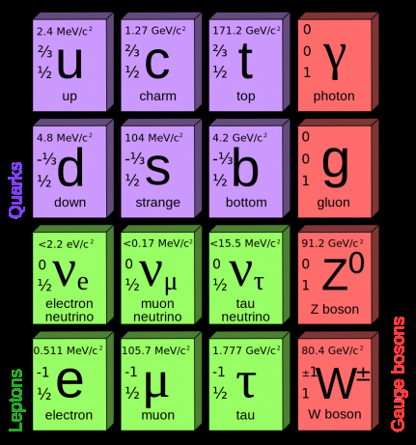
Symmetry = Truth?

Slide 29
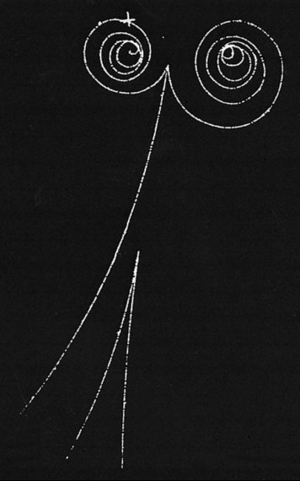

Slide 30
